Slide 1

DPMAP
A complete guide for supervisors

Slide 2
What action would you like to complete?
Create a Plan
Menu
Create a Progress Review
Create an Annual Appraisal

Slide 3

Beginning of Appraisal Cycle
Initiate a new performance plan
Includes a maximum of ten performance elements and related performance standards
Two approaches to creating a performance plan:
  Employee create the plan; or
  Create the plan for your employee.
Communicate with your employee
Notes:
This section focuses on your use of the system as a rating official and details how to use the Performance Management and Appraisal system to initiate, edit, view, and approve the performance plans of employees.
At the beginning of the rating cycle (normally April 1), you or your employee initiate a new performance plan. This is done for each employee you are responsible for rating. A new performance plan will be created in the middle of the cycle if a new employee is hired.
Performance plans include a maximum of ten performance elements and related performance standards. All elements are critical. You must have a minimum of one critical performance element.
There are two approaches to creating a performance plan:
• Notify your employee that you would like him or her to create the plan; or
• Create the plan for your employee.
In either case you should communicate with your employee about which option you choose, and what you expect if your employee is to create it. This is particularly important to avoid rework if your employee creates the plan and enters data that is incorrect or not what you expect. If you ask your employee to create the plan and enter performance elements, you must ensure he or she knows the relevant organizational mission/strategic goals.
Regardless of who initiates the performance plan, it can be left as an empty shell, in which the other party enters the objectives, or the person creating it can enter initial objectives. After the performance plan has been initiated, you and your employee can enter, edit, or review performance elements as much as needed before the final transfer from the employee to you for approval.

Slide 4
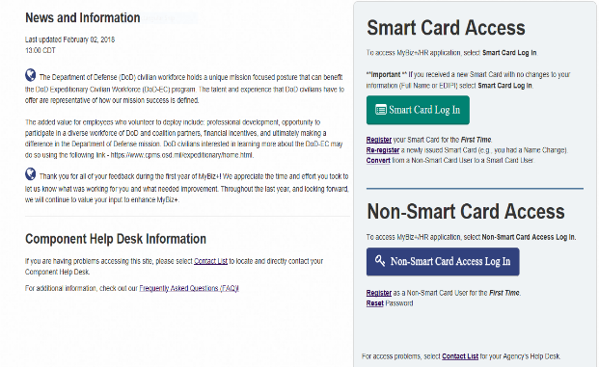
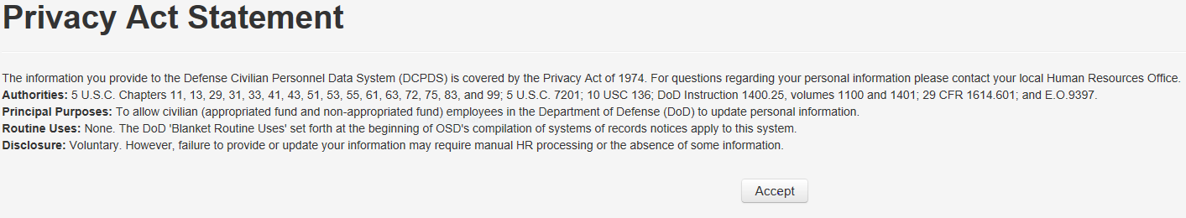
Go to https://compo.dcpds.cpms.osd.mil/ (MYBiz+)
Use CAC card to log in.
Select Certificate and click ok
Click accept on the Privacy Statement
Notes:
Go to https://compo.dcpds.cpms.osd.mil/ (MYBiz+) use your CAC card to log in. After you click on the correct certificate, click ok. Then read and click Accept on the Privacy Statement that pops up.

Slide 5
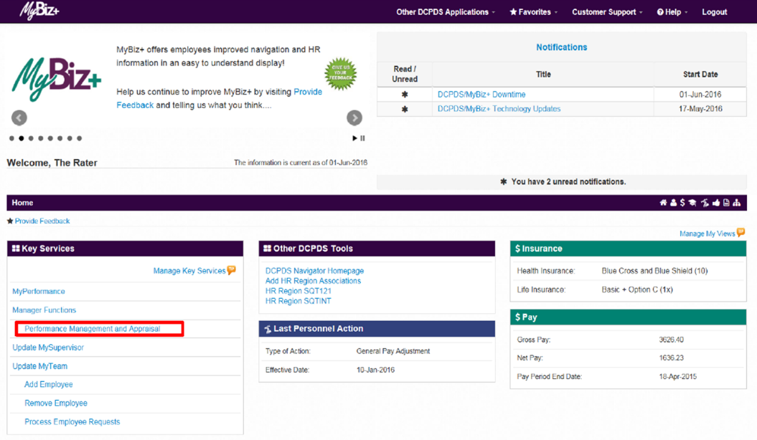
Select Performance Management and Appraisal
Can be found on lower left side of the screen.
Notes:
From the MyBiz+ home page, select Performance Management and Appraisal link under Manage Functions in Key Services on the lower left side of the screen.

Slide 6
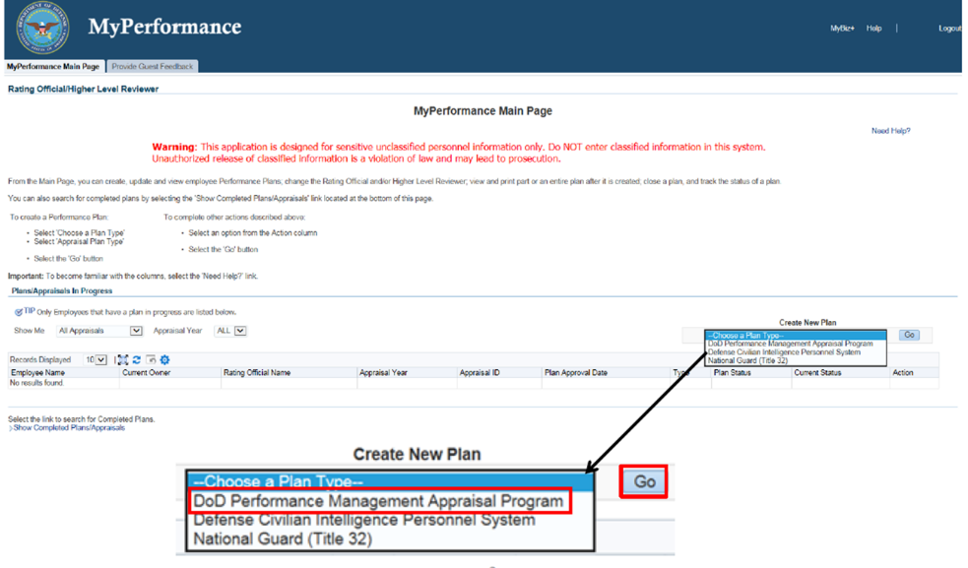
Click the drop down menu under Create a New Plan
Select DoD Performance Management Appraisal Program
Click Go
Notes:
You are now on the MyPerformance Main Page where you can create, update, and view your employees’ performance plans.
Follow these steps to create a performance plan for your employee.
On MyPerformance Main Page create a new performance plan by selecting ‘DoD Performance Management Appraisal Program’ from the Choose a Plan Type drop-down menu
The performance plan will clearly document for each employee how the expected outcomes and results are linked to the organization’s goals and objectives and how performance will be measured throughout the appraisal cycle.
From the Myperformance Main Page, under Create New Plan, select the Choose a Plan Type from the drop-down arrow.
Select DoD Performance Management Appraisal Program and the Go button.

Slide 7
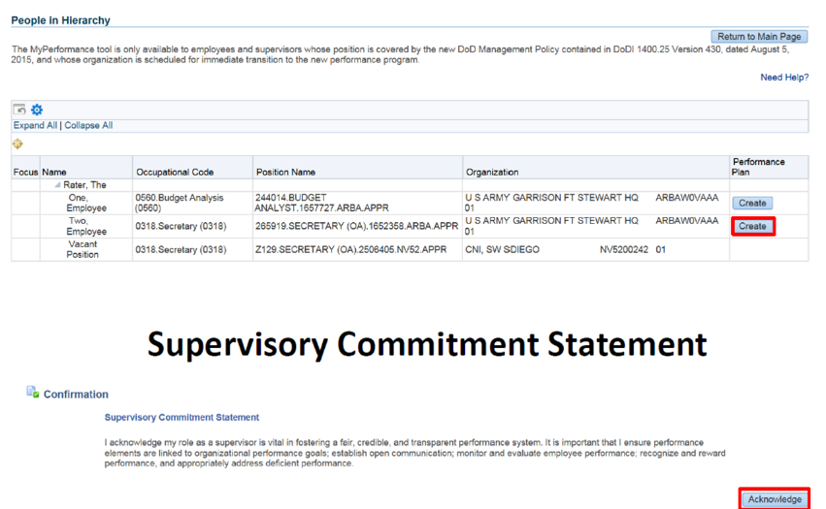
This is a list of your employees
Find employee you want to create a plan for
Click create to create a plan for that employee
Read your role and responsibilities
Click Acknowledge
Notes:
You will see all the employees in your hierarchy. From People in Hierarchy screen, find the employee you want to create a performance plan on and select the Create button.
Also, on the upper right hand corner of every screen, there is a “need help” button which will provide you assistance in the screen that you are working on.
When a rating official creates a new performance plan, the rating official must acknowledge (using Acknowledge button) that he or she has read and acknowledges their role and responsibilities during the appraisal period each time before working in MyPerformance. Select the Acknowledge button.

Slide 8
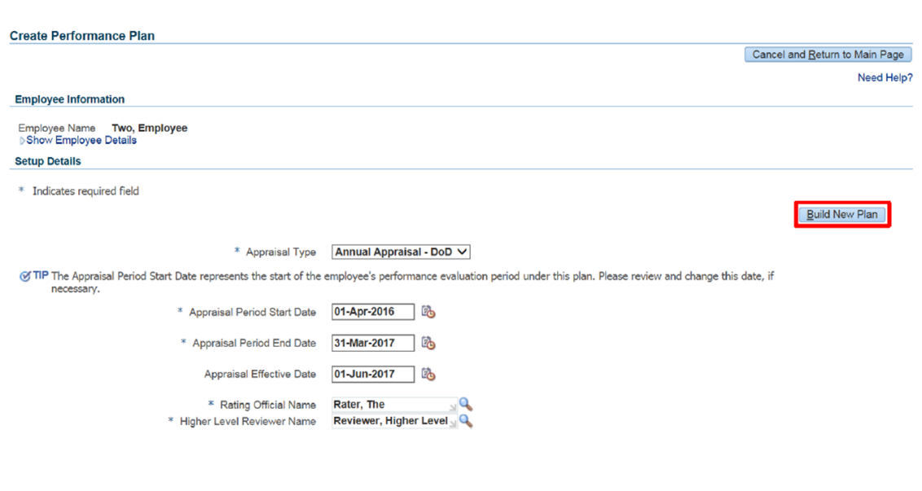
Click to show employee details. Click again to hide the details
Click to go to step 1
Review to make sure correct Dates, RO and HLR
Review for accuracy
Make changes, if necessary
Click Build a new plan
Notes:
The Create Performance Plan page is displayed. Review Setup Details and, if needed, make required changes.
Select Show employee details to see more about the employee then select the Hide Employee Details link to hide the employee’s position and organization information.
The appraisal cycle for employees covered by the DoD Performance Management and Appraisal Program is April 1 thorough March 31 of each calendar year.
Review the plan Setup Details information and make necessary changes to the default values.
Select Build New Plan button and go to Step 1: Plan Details.

Slide 9
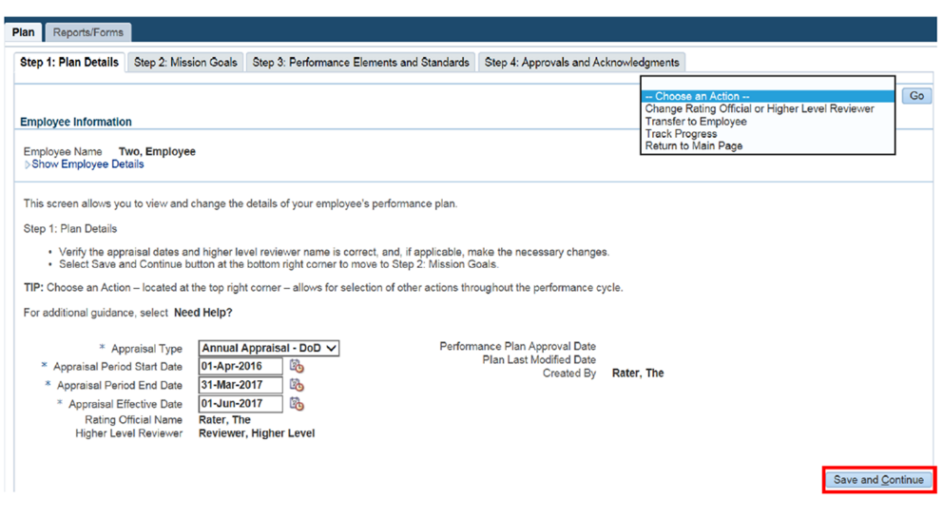


Review for accuracy
Click Save and Continue
Go to step 2: Mission Goals
Notes:
Choose an Action offers several options for the Rating Official to manage their employee’s performance plan/appraisal: Change Rating Official and or Higher Level Reviewer, Transfer to Employee, Track Progress, and Return to Main Page. The Choose an Action drop down is available for your use on every tab in MyPerformance.
This is the final review of the Setup Details, make necessary changes and select Save and Continue button to move to Step 2: Mission Goals

Slide 10
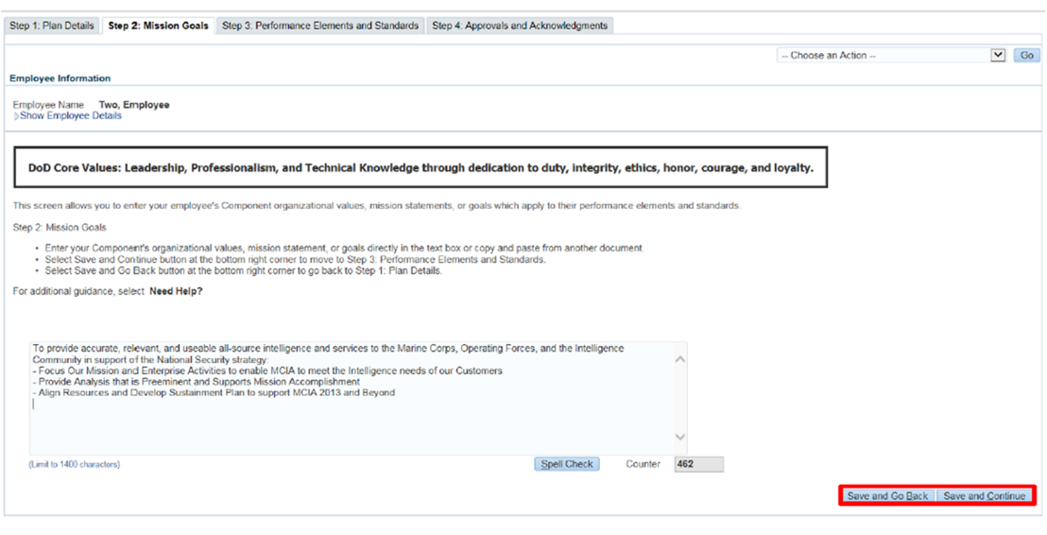


Mission goals go here
Enter Mission Goals in Text box
Click Save and Continue
Go to step 3: Performance Elements and Standards
Notes:
Enter mission goals in the text box (limit to 1400 characters). Spell Check is available.
Select Save and Continue to go to Step 3: Performance Elements and Standards.

Slide 11
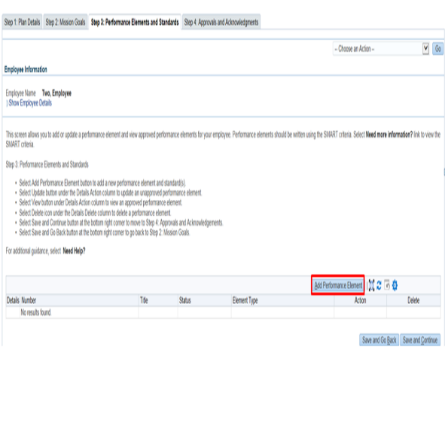
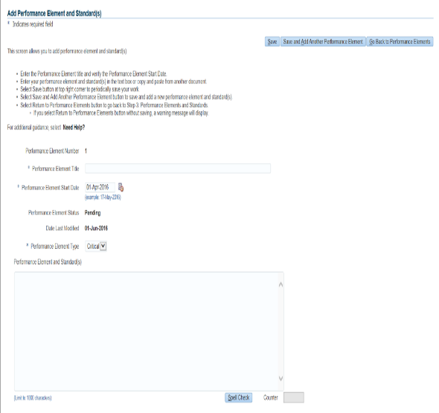

Or
Screen Shot 2
Screen Shot 1
Add a element title
Change if necessary
Add element
Screen shot 1-Click Add Performance element
Screen Shot 2-Add Element title and one element
Click Save or Save and add another Performance element
Add another performance element or Go to step 4: Approvals and Acknowledgements
Notes:
Performance Element Title-Give a brief description of the performance element. You may enter up to 80 characters
Performance Element Start Date-This field defaults to the current date.
Normally it should be the same as the Appraisal Period Start Date on the Create Performance Plan page, but it may be different if a performance element does not become active until a later date due to an anticipated change in your job responsibilities.
Performance Element Type-This field defaults to Critical
Performance Element and Standard(s) -Give a detailed description of the performance element. Performance elements and standard(s) should be specific, measurable, aligned, realistic, and timed (SMART). The character limit for this field is 1,000. An employee can have no more than 10 performance elements.
Select the Save button and then the Go Back to Performance Elements button when you have completed entering the performance elements.

Slide 12
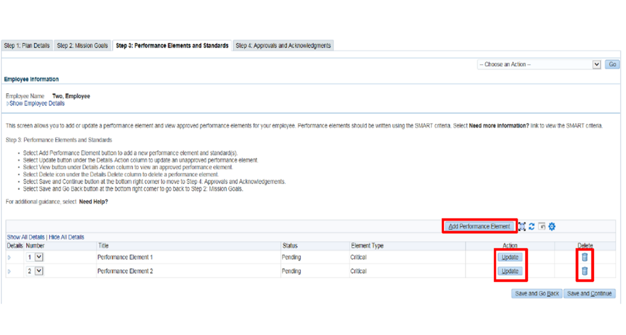
You can Add another performance
You can update the elements
You can delete the elements
Save and continue to Step 4: Approvals and Acknowledgements
Notes:
Since performance elements have been added, you can update, add, or delete a performance element as depicted in Figure 17. 13. You can review all the information you have entered on the performance plan before transferring it to your employee for review.
To view an individual performance element, select +Show. To collapse the performance element, select -Hide. This function is available throughout the application.
You can review all the information you have entered on the performance plan before transferring it to your employee for review.
To view an individual performance element, select +Show. To collapse the performance element, select -Hide. This function is available throughout the application.

Slide 13
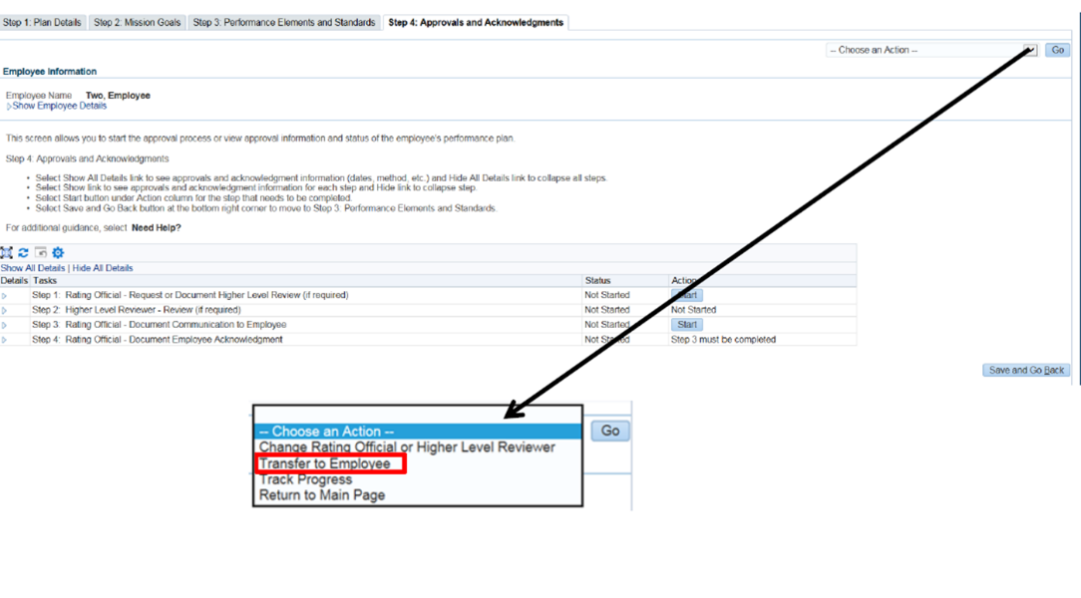
Click Transfer to employee
Click Go
Notes:
At this point you have completed your employee’s plan and are ready to transfer it to the employee for review. Select Transfer to Employee under the Choose an Action drop-down menu in the top right corner of the page.

Slide 14
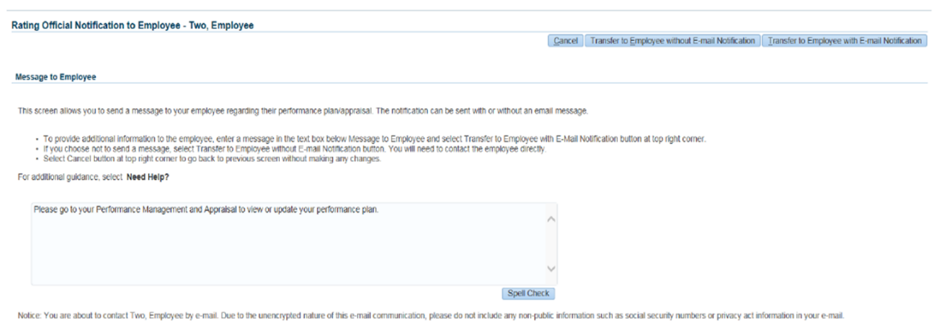
OR
If
Then
Enter the message to employee here.
Click either Transfer to Employee without Email Notification
Or Click transfer to Employee with Email Notification
Notes:
The Rating Official Notification to Employee is displayed. You have the option to transfer to the employee with or without e-mail notification. If you choose to enter comments in the Message to employee, your message will show up in the e-mail. Select Transfer to Employee without E-mail Notification or Transfer to Employee with E-mail Notification button to transfer the performance plan to your employee. NOTE: If the employee does not have an email address in DCPDS, the page that appears will only give you the option to send without email notification. You will also be advised to contact the employee to have them enter an email address for work using MyBiz+.
You will be navigated to the MyPerformance Main Page and will receive a confirmation that the plan/appraisal has been submitted to the employee. The performance plan is now displayed under Appraisals of (employee name) section on the MyPerformance Main Page. You no longer have ownership and can only view the performance plan.

Slide 15
Employee reviewed plan and sent back to supervisor
Begin the approval process
Click start next to Step 1 – will be sent to HLR
When HLR sends back, click start next to Step 3
Document the meeting with the employee by clicking on the Acknowledgement drop down
Change the date to reflect the day you met with the employee
Send to Employee for Acknowledgement
Notes:
After you and your employee have reviewed and concur with the performance elements and standards as written, you are ready for the performance plan approval.
During the approval process, you will document how the plan was delivered to your employee (i.e., face-to-face or telephone) and the date it was delivered.
If an employee is not available to acknowledge the plan or refuses to acknowledge the plan, you will need to document this information.
As described earlier, the typical steps in the performance plan process are as follows. The steps covered in this section are bold and italicized:
The employee or rating official creates the performance plan and enters draft performance elements and standards.
The employee and rating official edit and/or add to the performance plan content as needed. This process may involve multiple rounds of editing and transfers between the employee and rating official before the plan is finalized.
The performance plan is approved by the higher level reviewer, as appropriate, or the rating official documents the higher level reviewer approval.1
The rating official documents communication to employee and transfers the plan to the employee for acknowledgment.
The employee reviews the performance plan and acknowledges that it was communicated to him or her by the rating official.

Slide 16
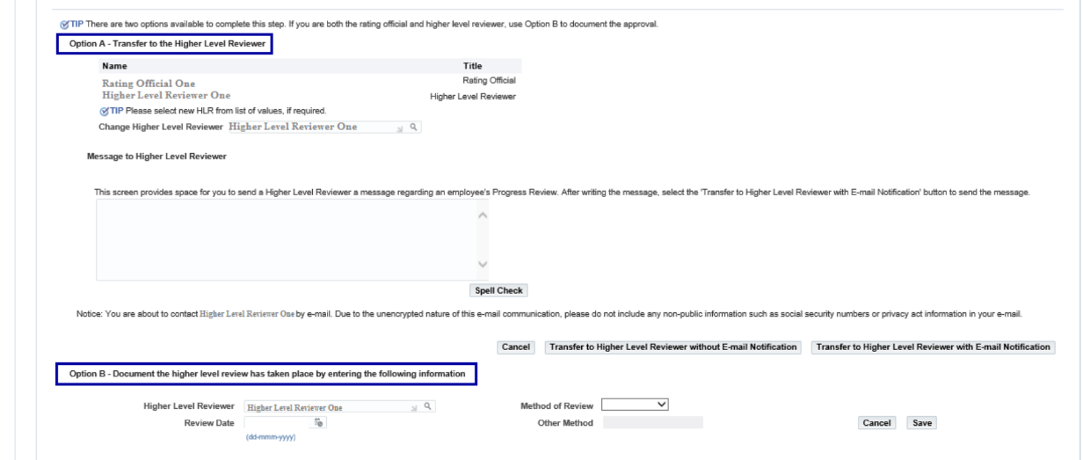
Use option A
Click transfer to HLR with email or without email
If sending with email add information in box below Message to HLR

Slide 17
After the higher level review official sends the plan back, click start next to step 3
Annotate the date you communicated with the employee
Click the drop down next to communication method
Select the communication method
Click safe and transfer to employee for Acknowledgement

Slide 18
Create Progress Review
Complete in the middle of the rating cycle
Go to DCPDS link: https://compo.dcpds.cpms.osd.mil/
Accept the DoD Notice and Consent Banner
Select button 'Smart Card Log In'
Select certificate
Select HR Mybiz+ Tile
Accept Privacy Statement
Select Performance Management and Appraisal link located under ‘Manager Functions’
Notes:
Go to DCPDS link: https://compo.dcpds.cpms.osd.mil/
Accept the DoD Notice and Consent Banner
Select button 'Smart Card Log In'
Select signature certificate
Select HR Mybiz+ Tile
Accept Privacy Statement
Select Performance Management and Appraisal link located under ‘Manager Functions’
MyPerformance Main Page: It’s very important that the action column reflects ‘Update’ for the employee appraisal you want to document. If the action is ‘View’, select the drop down arrow and select ‘Retrieve’ from the list. The action status will change from ‘View’ to ‘Update’.

Slide 19
Select ‘Go’ button
If Update not an option employee send back to you
Notes:
Select ‘Go’ button on the employee plan/appraisal that you want to create a Progress Review

Slide 20
Progress Review
Click Progress Review Tab

Slide 21
Create Progress Review
Click Create Progress Review
Click transfer to employee then go
Same screen to add Another Progress Review
Transfer to employee will transfer current Progress Review only.
Notes:
After you create the Progress Review, transfer the Progress Review to the employee to provide their input. After the employee provides input, the employee will send the progress review back to you.
To create an additional progress review, you must have ownership of the plan, create another progress review in the same area that you created the first progress review. Then transfer the progress review to the employee to provide their input. When you click Transfer to employee, only the current progress review will be sent to the employee for input.

Slide 22
Assessments
Type in Rating Official Assessment
Click Go to Next Performance Element
Type in rating Official Assessment for that Performance Element
Repeat steps if more Performance Elements
Employee Input
There is a 2,000 character limit in this text box. Input the Progress Review Information here.
Spell Check functionality is available.
Rating Official Assessment
There is a 2,000 character limit in this text box. Input the Progress Review Information here.
Spell Check functionality is available.
Go to Next Performance Element
Notes:
On this page, by default, the ‘Assessment’ tab is the tab shown after selecting the create progress review button. As you can see, both you and the Employee have respective blocks for each Performance Element and Standard(s) to enter comments.
5. Review the Performance Element selected.
Enter the assessment in the Rating Official Assessment text box.
Select the ‘Go to Next Performance Element’ button and repeat Step 6 for that Element.
Note: The information entered in each ‘Assessments’ block automatically saves when navigating to the next element, etc.

Slide 23
Click Go Back to Progress Review

Slide 24
Click transfer to Employee
Click Go
Notes:
Transfer the Progress Review to Employee by selecting the ‘drop down’ arrow and select ‘Transfer to Employee’ action from list and select the ‘Go’ button. (See action list below)

Slide 25
OR
Click Transfer to employee
Click Transfer with Email Notification or
Click Transfer Without Email Notification
Notes:
Enter message to the employee in text box and select ‘Transfer to Employee with E-mail Notification’ button.
Confirmation message received: ‘The appraisal has been submitted to the employee’.
The employee is currently the owner and you no longer have ‘Update’ capability and only have ‘View’.

Slide 26
Progress Reviews
Click Go
Click Acknowledge
Click Progress Reviews

Slide 27
Click update
Click Approvals and Acknowledgements tab
Click Start for Step 1, if required. If not required, click start next to step 3
Go through the steps for acknowledgement
Notes:
Select the ‘Start’ button for Step 1. If this step is not required, select ‘Start’ button to Step 3.
Progress Reviews Information Area Page
Step 1: Rating Official – Request or Document Higher Level Review, if required. There are two options for this step and they are as follows:
Option A – Transfer to the Higher Level Reviewer (this options transfers the plan/appraisal (Progress Review) to the HLR for their action)
- Enter message to HLR in text box and select the ‘Transfer to Higher Level Reviewer with or without E-mail Notification’ button
- You will receive a Confirmation (the appraisal has been submitted to the Higher Level Reviewer)
- The HLR owns plan/appraisal (Progress Review) and you only ‘View’ under ‘Action’ column
- The Current Status will be ‘Progress Review Pending HLR Approval’
Option B – Document the higher level review has taken place by entering the following information (this option allows you to manually document the review of progress review that took place with HLR)
- Higher Level Reviewer Name Auto Populates (no action needed)
- Review Date (this is the date review took place between you and the HLR)
- Method of Review (what was the method used for review, i.e., Face to Face, Telephone and Other)
- Select ‘Save’ button to complete the HLR step 21. Select the ‘Start’ button for Step 3: Rating Official – Document Communication to Employee
Enter the Communication Date (e.g., 01-Oct-2018). This is the date the progress review was communicated to employee (can be a past date).
Identify the Communication Method – Select the drop down arrow and select method from list (e.g., Select ‘Other’ from list and enter ‘Fax’ in the ‘Other’ block).
Action Buttons:
a. Cancel – returns you to previous page
b. Save and Transfer to Employee for Acknowledgment – transfer the progress review to the employee for them to acknowledge
c. Save and go to Step 4 – if the employee is unavailable to acknowledge their progress review, select this button and you will need to complete Step 4 (Rating Official – Document Employee Acknowledgment)
For this step, select the ‘Save and Transfer to Employee for Acknowledgment’ button.
Rating Official Notification to Employee: Enter message and select the ‘Transfer to Employee with E-mail Notification’ button.
Confirmation message received:
You will have ‘View’ only to the plan/appraisal until such time the Employee Transfers it back to you.

Slide 28
Use option A
Click transfer to HLR with email or without email
If sending with email add information in box below Message to HLR

Slide 29
After the higher level review official sends the Progress Reviwe back, if required, click start next to step 3
Annotate the date you communicated with the employee
Click the drop down next to communication method
Select the communication method
Click save and transfer to employee for Acknowledgement

Slide 30
Annual Appraisal
Complete at the end of the rating cycle
Go to DCPDS link: https://compo.dcpds.cpms.osd.mil/
Accept the DoD Notice and Consent Banner
Select button 'Smart Card Log In'
Select certificate
Select HR Mybiz+ Tile
Accept Privacy Statement
Select Performance Management and Appraisal link located under ‘Manager Functions’

Slide 31
Click on Annual Appraisal Tab
Notes:
The rating official must transfer the appraisal t the employee to provide their input for the annual appraisal. Once entered, the employee will transfer the appraisal back to the rating official.

Slide 32
Assessments and Ratings Tab
Employee added their input
Rater will add their assessment
Click Dropdown to add rating for this element
Click when finished all elements
Add assessment
Click Dropdown add rating
Click go to next performance element
Notes:
On this page, you will enter the rating official’s assessments and assign elements ratings.
Select the radio button next to each performance element to display the element and employees input
Enter your assessment in the Rating Official Assessment text box for each element. (Up to 2000 characters)
Select the Spell Check button to check the spelling of the text.
Assign Performance Element Rating
1-Unacceptable
3- Fully Successful
5-Outstanding
NR-Rating is for employees who did not have an opportunity to perform the element because it became obsolete or could not be accomplished due to extenuating circumstances.
Repeat these steps until all performance elements are evaluated
Select the Save and Continue button.

Slide 33
Rating of Record
Save and Continue
Click on the Rating of Record Tab
Check for updates
Select Save and Continue
Notes:
On this page, review the Average Score and Rating of Record. If changes are required to an element select the Save and Go Back button and make your adjustments and select the Save and Continue button. If no adjustments are required, select the Save and Continue button.

Slide 34
Click Approvals and Acknowledgements tab
Click Start for Step 1
Go through the steps for acknowledgement

Slide 35
Use option A
Click transfer to HLR with email or without email
If sending with email add information in box below Message to HLR

Slide 36
After the higher level review official sends the appraisal back, click start next to step 3
Annotate the date you communicated with the employee
Click the drop down next to communication method
Select the communication method
Click save and transfer to employee for Acknowledgement

Slide 37

YOU DID IT!
You completed a performance appraisal!

Slide 38

Questions?

